Slide 1

CSG1105 / CSG5130
Applied Communications
Chapter 3
Networking Hardware

Slide 2
Objectives
List and describe the basic networking hardware components, including cabling, network interface cards, repeaters, transceivers, hubs, switches, routers, and firewalls
Explain the differences and similarities between 10base2 Ethernet, 10base5 Ethernet, 10baseFL Ethernet and 10baseT Ethernet

Slide 3
Objectives (cont’d.)
Compare the advantages of fiber optic cable over copper wire
Understand the relationship between network devices and the OSI network model
Describe the basic operation of Ethernet hubs and switches

Slide 4
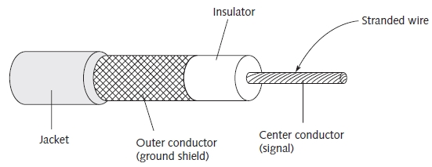
Ethernet Cabling
Three main varieties
  RG-58 coaxial cable (thinwire): 10base2 operation
  RG-11 coaxial cable (thickwire): 10base5 operation
  Unshielded twisted pair (UTP)
    10baseT, 100baseT, 1000baseT operation
Specialized cables: Fiber optic cable (10baseFL)
Figure 3-1 Coaxial cable construction

Slide 5
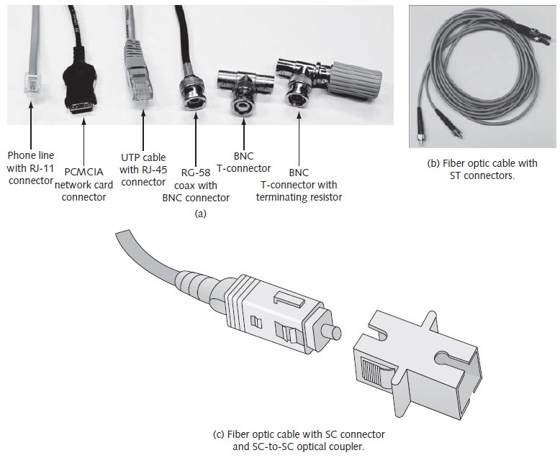
Ethernet Cabling (cont’d.)
Figure 3-2 Ethernet cabling

Slide 6
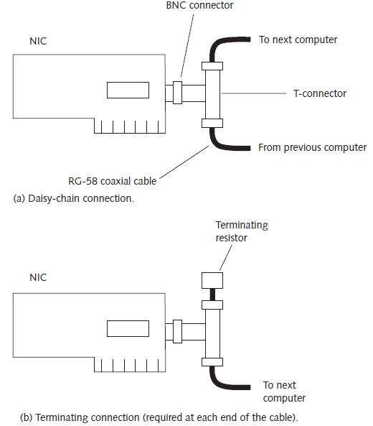
Ethernet Cabling (cont’d.)
Connect machines using daisy-chain approach
Figure 3-3 10base2 Ethernet wiring

Slide 7
Ethernet Cabling (cont’d.)
RG-11 coaxial cable
  Backbone cable
UTP cable
  Used with hubs, switches, and other 10/100baseT equipment
  Twisted pair wires
    Reduces noise and crosstalk
    Allows higher-speed data rates

Slide 8
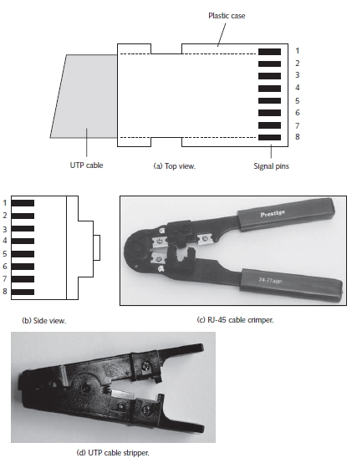
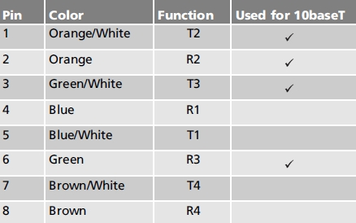
Ethernet Cabling (cont’d.)
Table 3-1 RJ-45 pin assignments
(568B standard)
Figure 3-4 RJ-45 (10baseT) connector

Slide 9

Ethernet Cabling (cont’d.)
Figure 3-5 RJ-45 cabling
UTP wiring
  Straight-through or crossover cables

Slide 10
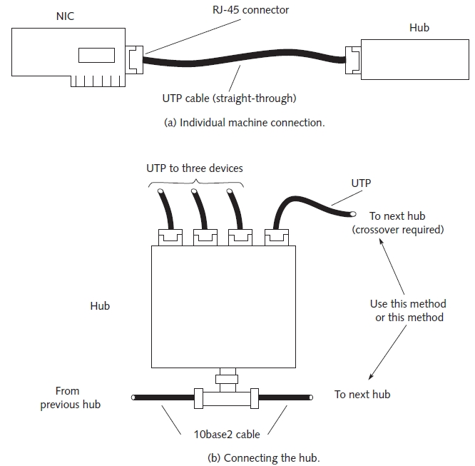
Ethernet Cabling (cont’d.)
Figure 3-6 10baseT Ethernet wiring

Slide 11
Ethernet Cabling (cont’d.)
Fiber optic cable
  Light pulses carry information
Construction
  Plastic or glass with different physical properties
    Light beam reflects off boundary between core and cladding
Single mode or multi-mode allowed
Advantage
  Eliminates problems found in copper wires
Disadvantage
  Fragile

Slide 12
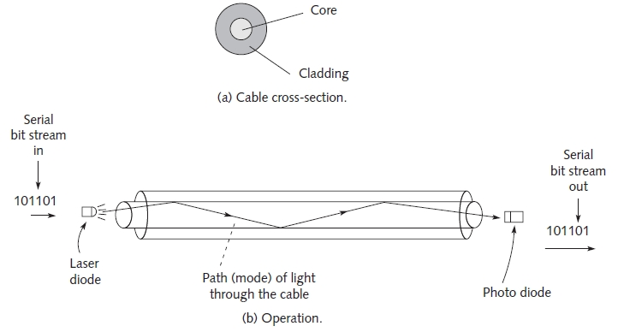
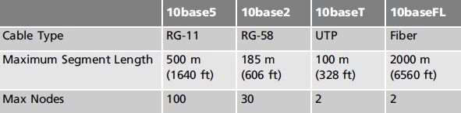
Figure 3-7 Fiber optic cable
Table 3-2 Comparing cabling systems

Slide 13
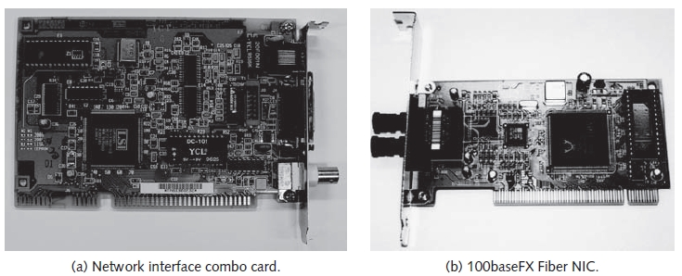
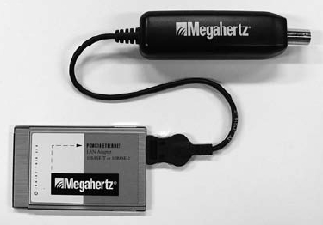
The NIC
Interface between networked device and physical network connection
  Connects to coaxial, UTP cable, fiber segment
  Operates in OSI model Physical layer
Figure 3-8 Two types of NICs
Figure 3-9 PCMCIA Ethernet
card with cable

Slide 14
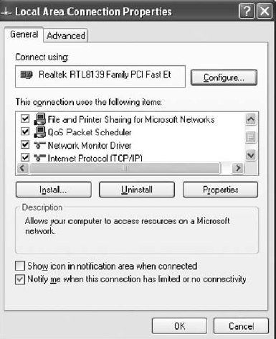
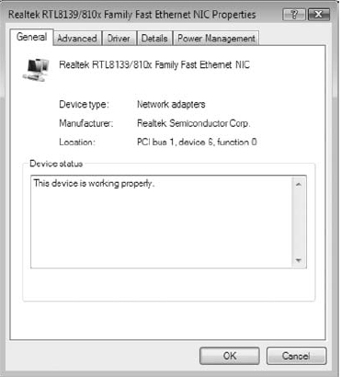
The NIC (cont’d.)
Windows XP and Vista
  Identify installed NIC in Local Area Network properties
Figure 3-10(b) Windows XP
Realtek RTL8139 NIC entry
Figure 3-10(c) Windows Vista
Realtek RTL8139/810x NIC entry

Slide 15
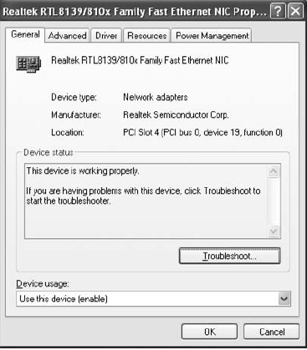
The NIC (cont’d.)
To examine NIC properties (Windows XP, Vista)
  Click Configure button
Figure 3-11(b) Windows XP
NIC Properties window
Figure 3-11(c) Windows Vista
NIC Properties window

Slide 16
The NIC (cont’d.)
NDIS/ODI interface decouples protocols from NIC
  Protocols use NDIS/ODI drivers to perform network operations
  Drivers responsible for specific hardware
Unique 48-bit MAC address
  First six digits: manufacturer, vendor
  Last 6 digits: NIC serial number
NIC utilizes two addresses
  MAC address: assigned by manufacturer, unique
  IP address: assigned by operating system, may change

Slide 17
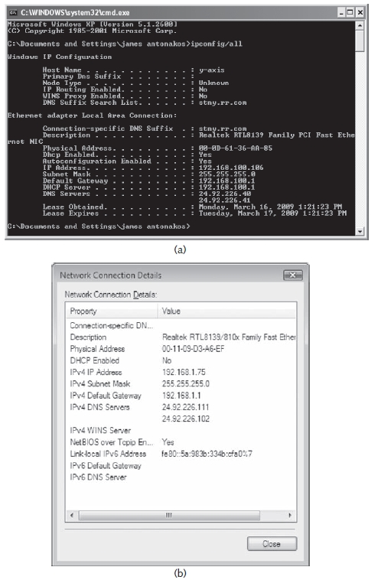
Figure 3-13 Viewing the NIC’s MAC (Adapter) address
using (a) IPCONFIG and (b) Windows Vista

Slide 18
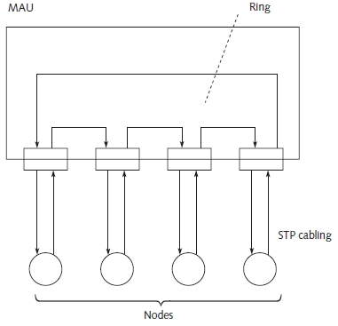
Token-Ring
Mid-1980s: 4-Mbps (16-Mbps available)
Multistation access unit (MAU)
  Establishes ring connection
Connections made using STP cables
Figure 3-14 Token-ring network

Slide 19
Repeaters
Connects two network segments
  Broadcasts packets between the segments
  Amplifies signal, extends usable length
Common Ethernet rule
  Four repeaters can join up to five segments maximum
  Physical limitation
    Designed to keep collision detection (CSMA/CD) working properly
Operates at OSI model layer 1 (Physical layer)

Slide 20
Transceivers
Convert transmissions from one media type to another
  Common to use more than one media type in an installation
    Many different transceivers available
Operates at OSI model layer 1
Important when upgrading a network

Slide 21
Hubs
Expands one Ethernet connection into many
Similar to repeater
  Difference: hub broadcasts data received by any port to all other ports on hub
Contain small amount of intelligence
  Examines received packets, checks for integrity
Operates at Physical layer
Limit to number of hubs connected in series

Slide 22
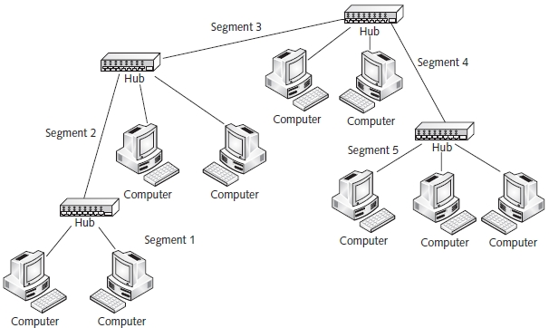
Hubs (cont’d.)
Figure 3-17 Connecting five 10baseT segments with hubs

Slide 23
Bridges/Switches
Bridge
  Partition large network into smaller groups
  Learns which packets cross segments
Switch
  Enhancements over bridge
    Multiple ports for directing packets
    Store-and-forward
    Auto-sensing
    Simple network management protocol (SNMP) support
Operate at OSI model layer 2 (Data-Link)

Slide 24
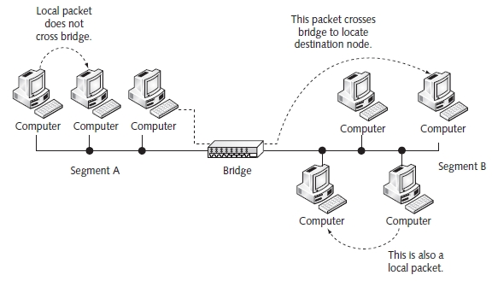
Bridges/Switches (cont’d.)
Figure 3-18 Operation of a bridge

Slide 25
Routers and Firewalls
Router
  Basic Internet building block
  Connects two or more networks together
  Examines each packet
  Connects networks using:
    Different technologies, addressing methods, media types, frame formats, and speeds
  Special-purpose device
    Interconnects networks
  Maintains routing tables
    Stores information about network physical connections

Slide 26
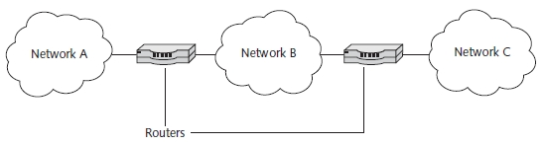

Routers and Firewalls (cont’d.)
Figure 3-21 Two routers connecting three networks
Table 3-3 Network components and their associated OSI model layer of operation

Slide 27
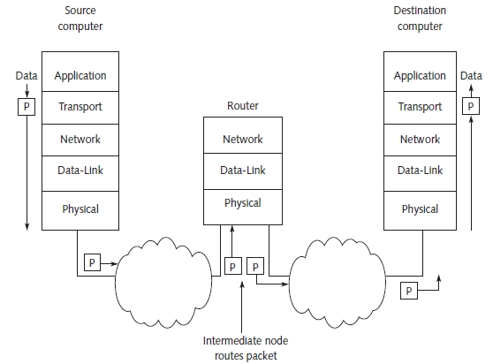
Routers and Firewalls (cont’d.)
Figure 3-22 Packet routing

Slide 28
Routers and Firewalls (cont’d.)
Firewall
  Hardware device, software program
    Inspects network traffic
    Allows or denies traffic according to rule set
  Purpose
    Protects a network and computer from outside access

Slide 29
Cable Modems
High-speed network device
  Connected to local cable television provider
Data transmission
  Uses pair of channels (transmit, receive) on cable system
Internet service provider (ISP) service
  At head-end of network: cable supplier office
  Uses traditional telecommunications devices
Subscribers to cable modem service
  Use a splitter to create two cable wires

Slide 30
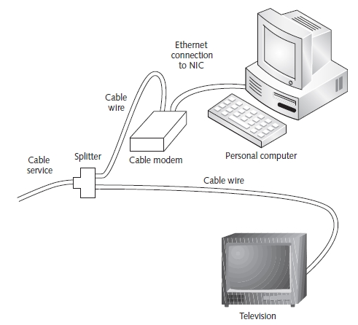
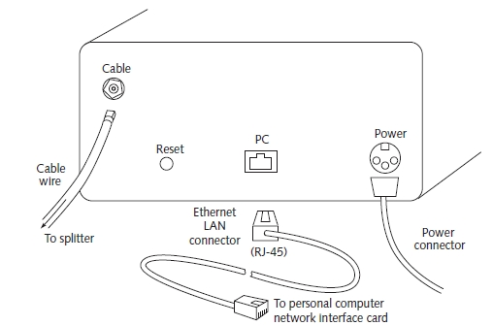
Cable Modems (cont’d.)
Figure 3-24 Cable service connections
Figure 3-25 Cable modem connections

Slide 31
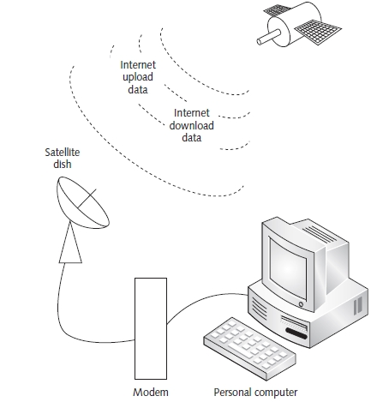
Satellite Network System
HughesNet Internet satellite networking system
  Internet data download speed: 500Kbps to 800Kbps
  Upload speed: 128Kbps
Figure 3-27 Satellite Internet

Slide 32
Exotic Hardware and Software
Replace multiple 16-port switches
  Use single industrial switch
    64 ports or more with port management
Networks distributed over large geographic area
  Use line-of-sight infrared lasers
  Use fiber repeaters
Wireless Ethernet hardware
Security purposes
  Use network-ready cameras
Advanced network management software

Slide 33
Troubleshooting Techniques
Expensive to buy finished cables
Test equipment available for custom-made cables
  Cable tester
    Used in preparing and testing custom-made cables
  Fluke LANMeter, other sophisticated test equipment
    Capture and diagnose network packets, gather statistics, perform standard network operations, transmit packets for troubleshooting purposes
Approach troubleshooting with a fresh mind

Slide 34
Summary
Ethernet networks use different types of cables
  RG-58, RG-11, UTP, Fiber
NICs interface between node, physical connection
Token-ring networks use MAU to connect computers
Devices connect network segments
  Repeater, transceiver, hub, bridge, switch, router
Firewall protect network
Cable modems connect computer to ISP
Many exotic devices available
Network hardwire trouble shooting tools available

